Slide 1
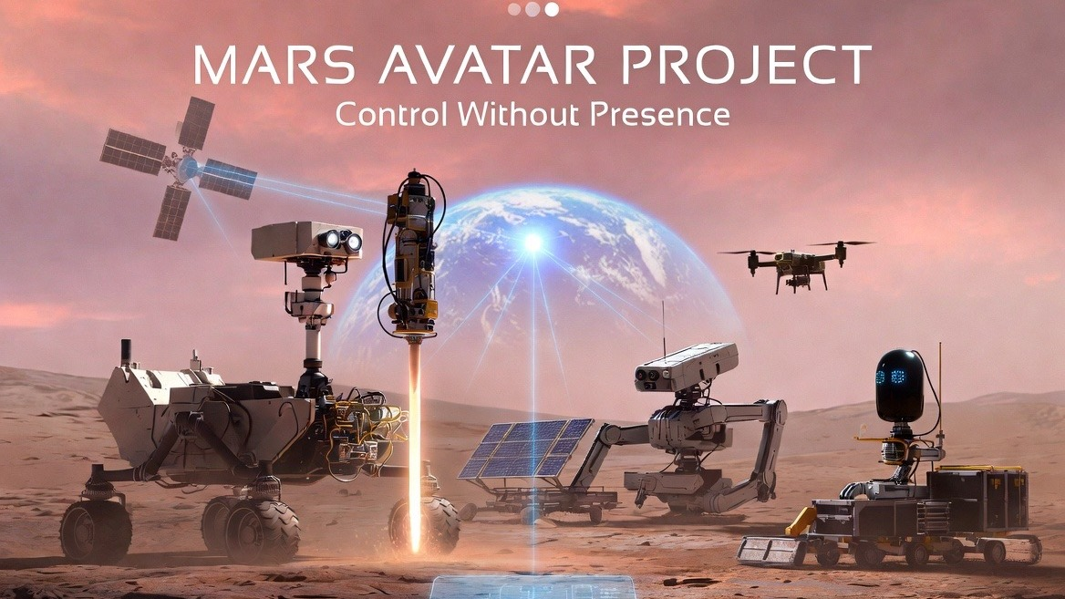

Slide 2
THE PROBLEM
Why not send humans right away
01
Radiation
Beyond Earth's magnetic field, crews are exposed to cosmic rays — raising the risk of cancer and other diseases.
02
2+ year mission
The flight, the wait for a return window, the trip home. All that time: food, water, oxygen, medical care.
03
Human limits
Fatigue, short surface excursions, errors under workload. A robot works without breaks.
04
Cost
A crewed program starts at $100B. Robots need no life support and no return trip.
The project doesn't cancel human flights — it prepares safe and affordable ground for them.
MARS AVATAR PROJECT
02

Slide 3
THE PROBLEM
The core barrier: signal delay
A signal travels at the speed of light — and never faster:
4 min
delay, minimum
12 min
delay, average
22 min
delay, maximum
Blackouts
during solar conjunction the link is lost entirely
Real-time “joystick” control of a robot is impossible in principle.
So the system must be designed around the delay, not against it.
MARS AVATAR PROJECT
03

Slide 4
THE IDEA
The idea: intelligence on Earth, presence on Mars
Operator
sets goals
and constraints
Mission Control
plans the mission,
builds command packages
Comms link
relay satellites
and laser channels
Local AI
decides the “how”,
compensates for delay
Robotic avatars
explore and build
on the surface
→
→
→
→
“Control Without Presence”: AI does not replace the human — it extends the human's
ability to act across interplanetary distances.
MARS AVATAR PROJECT
04

Slide 5
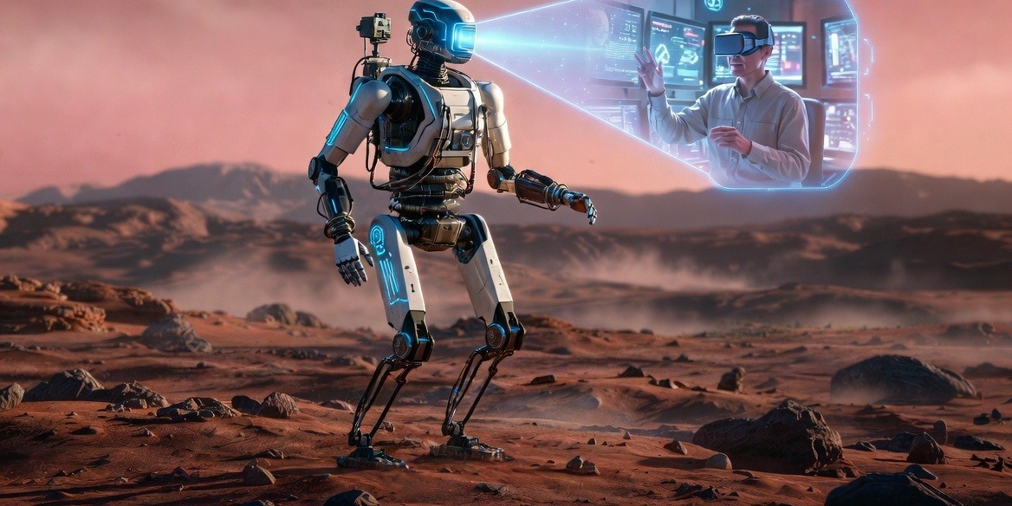
CONTROL
Command goals, not movements
Traditional teleoperation
“Turn right. Drive 20 meters. Raise the arm.”
With a 20-minute delay, this simply fails.
Mars Avatar Project
“Collect a rock sample near the crater.”
One goal — the robot plans and executes everything else itself.
Given a goal, the local AI on its own:
plans the route → avoids obstacles → assesses safety → performs the task → sends a report
The approach is proven: NASA's rovers have been driven for decades by daily command packages, not a joystick.
MARS AVATAR PROJECT
05

Slide 6
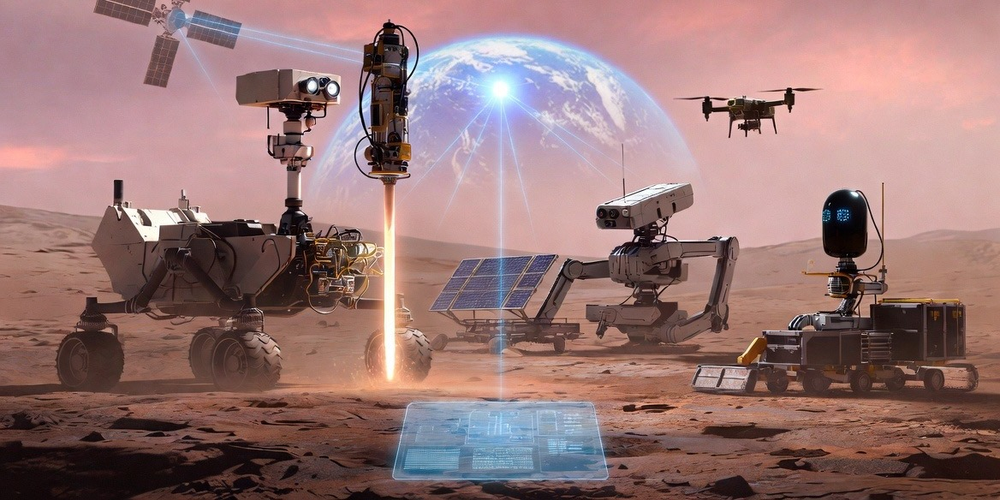
ROBOTS
A fleet of specialists instead of one robot
Science rover — geology, drilling, sample collection, ice prospecting
Builder — solar panel installation, module assembly, cabling
Cargo — delivery of equipment, materials, and samples
Drone — reconnaissance, mapping, finding safe routes
Laboratory — chemical and biological analysis on site
A single Mission AI coordinates the fleet: 1 robot → 10 platforms → hundreds of machines in one network.
Maintenance — diagnostics and repair of the other robots
MARS AVATAR PROJECT
06

Slide 7
CONTROL
Who decides what: humans stay in command
Every action falls into one of three classes — the Human-in-Command principle:
Class A — critical
First drilling of a new rock type, driving a steep slope, irreversible use of a resource.
Approved by the operator on Earth · hours
Class B — standard
Route in a surveyed zone, sampling by a validated procedure, charging.
Decided by Mission AI, reported to Earth · seconds–minutes
Class C — internal
Stabilization, thermal control, obstacle avoidance, self-diagnostics.
Platform's onboard AI · milliseconds
As trust accumulates, routine moves from Class A to Class B — autonomy grows in a controlled way.
MARS AVATAR PROJECT
07

Slide 8
COMMUNICATIONS
Communications: what exists and what brings the leap
Today
The Mars Relay Network (MRO, Odyssey, MAVEN, TGO) already carries almost all rover data to Earth.
267 Mbit/s
demonstrated by NASA's DSOC laser experiment at 31 million km — a ×10–100 gain over radio.
Tomorrow
Streams of 3D maps and video from Mars: telepresence stays delayed, but stops being starved of data.
Communications is the project's most mature technology — it can start growing today.
MARS AVATAR PROJECT
08

Slide 9
PROOF
Not science fiction: the components already work
88%
of Perseverance's traverse is driven autonomously — AutoNav plans the route itself (NASA)
ISS → Earth
in ESA's Analog-1 experiment, an astronaut in orbit operated a rover on Earth, including soil sampling
$10M
the ANA Avatar XPRIZE competition proved the maturity of immersive avatar robots
25+ yrs
AI has flown spacecraft autonomously since Deep Space 1 (1999); AEGIS picks science targets on Mars
The project's novelty is not in individual technologies but in their system integration:
commanding an entire fleet from Earth under full interplanetary delay.
MARS AVATAR PROJECT
09

Slide 10
ECONOMICS
Economics: an order of magnitude cheaper
$14–23B
a fleet of 10 robots + 2 relays,
10+ years of surface operation
≤ 1 t
landing mass — a technology
already proven by real missions
≥ $100B
the lower estimate of a crewed program,
~500 days on the surface
An honest caveat: on reaction speed and scientific intuition, humans are unmatched.
So the project is not a replacement for people — it makes their arrival cheaper and safer.
MARS AVATAR PROJECT
10

Slide 11
ROADMAP
Roadmap: five steps
I
Earth
2026–2030 · prototype: real robots, artificial 20–30 min delay
II
Moon
2030–2035 · testing closer to home: multiple robots, construction, endurance
III
Mars
2035–2045 · first missions: landing pads, power, scouting base sites
IV
Infrastructure
a network of stations, depots and labs — a robotic base
V
Humans
crews arrive in a partially prepared environment
→
→
→
→
Each stage begins only after the previous one is verified —
reducing risks and inflated expectations.
MARS AVATAR PROJECT
11

Slide 12
RISKS
Risks and the principle of engineering honesty
The project openly grades its technologies by maturity:
Available today
rovers, relay satellites, autonomous navigation, deep-space links — proven in real missions
Projected
fleet coordination under one Mission AI, laser links at Mars, growing autonomy
Needs breakthroughs
full telepresence, high-performance brain–computer interfaces — long-term research
The main risks are hardware wear, dust, power, and AI errors. The project's answer: redundancy,
modularity, a safe mode on loss of link, and stage-by-stage verification of every hypothesis.
MARS AVATAR PROJECT
12

Slide 13
SUMMARY
The essence in three lines
Humans decide.
Goals, priorities, and critical actions always stay with the operator on Earth.
AI executes.
Autonomy is the only way to work with a 4–22 minute delay.
Robots are present.
A fleet of avatars explores and builds — preparing Mars for humans to arrive safely.
“The future of planetary exploration may depend not only on where humans can travel,
but on how effectively human intelligence can be extended through intelligent machines.”

Slide 14
